Slide 1
Peak Detection in Time Series
Presentation of Final Results
Nestor Weidemann, Nathira Wijemanne
Autonomous Multisensor Systems Group
Institute for Intelligent Cooperating Systems
Faculty of Computer Science
Otto von Guericke University Magdeburg
16.09.2025

Slide 2
Overview
Slide number “3/…” instead of just “3”
Adapt names in footer depending on who is presenting
Add sources for all “external” graphics
Peak Detection in Time Series | N. Weidemann, N. Wijemanne

Slide 3
1.
Introduction
2.
Experimental Setup
3.
Results
4.
5.
Evaluation
Conclusion
Peak Detection in Time Series | N. Weidemann, N. Wijemanne

Slide 4

1. Introduction
2.
3.
4.
5.
Motivation
Sustainability and energy efficiency
CNC machines are widely used in modern manufacturing
Peak Detection in Time Series | N. Weidemann, N. Wijemanne
Notes:
Automated production processes are industry standards
Energy efficiency and machine longevity affect on environmental and economic performance
A milling machine is a tool that uses rotating cutting bits to remove material from a workpiece, shaping it into precise dimensions and features
A CNC (Computer Numerical Control) machine automates this process by following programmed instructions, allowing for highly accurate and repeatable machining of complex parts

Slide 5
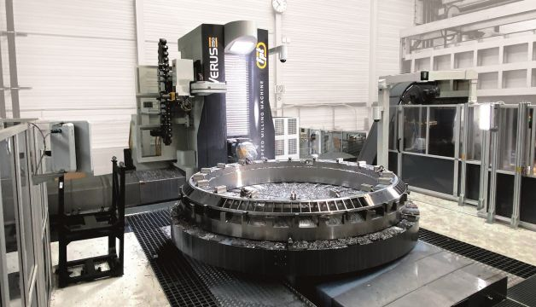
1. Introduction
2.
3.
4.
5.
Problem
Sudden power surges can occur in the motor current of a milling machine
Consequences
Stress on the drive electronics, leading to a reduced motor lifespan
Increase in energy consumption
Peak Detection in Time Series | N. Weidemann, N. Wijemanne
Notes:
Important to distinguish between normal power increases (e.g. caused by the tool engaging with material) and abnormal peak anomalies

Slide 6
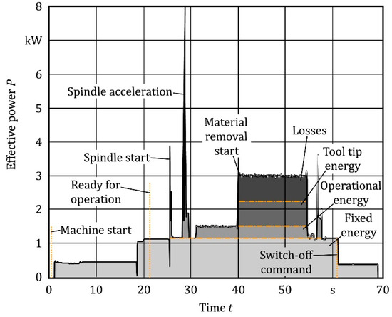
1. Introduction
2.
3.
4.
5.
Task
Implement and compare different approaches for peak detection
Goal
Identify sudden power surges
Detect anomalies or inefficiencies
Peak Detection in Time Series | N. Weidemann, N. Wijemanne
Notes:
Use Case: Milling Machine
The information can then be used to find errors in the G-Code

Slide 7
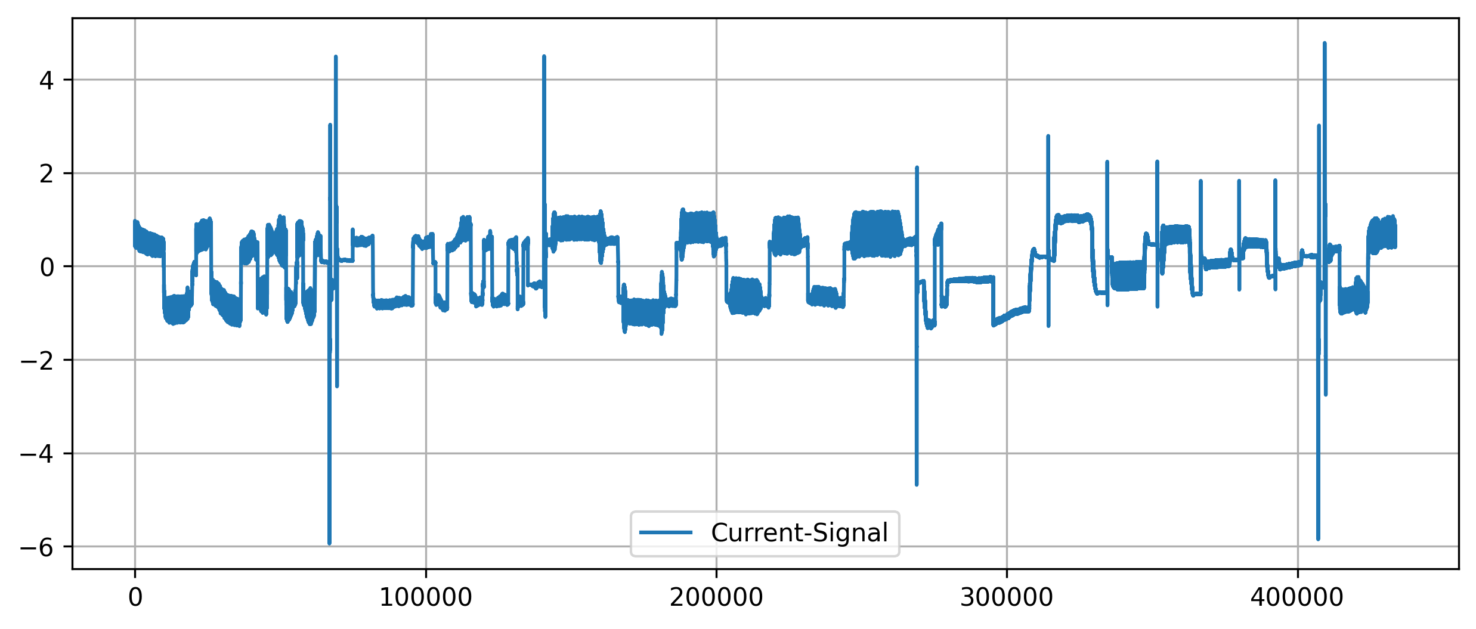
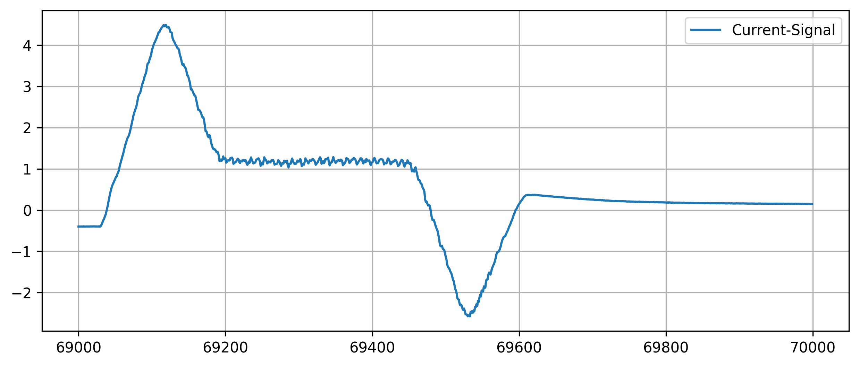
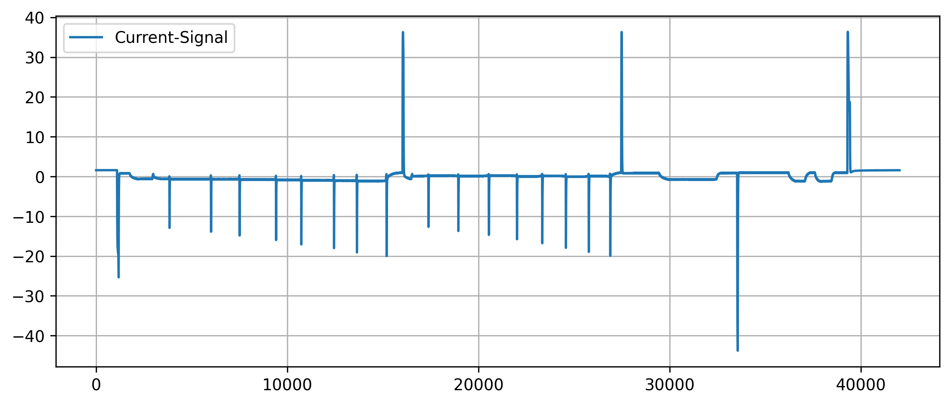
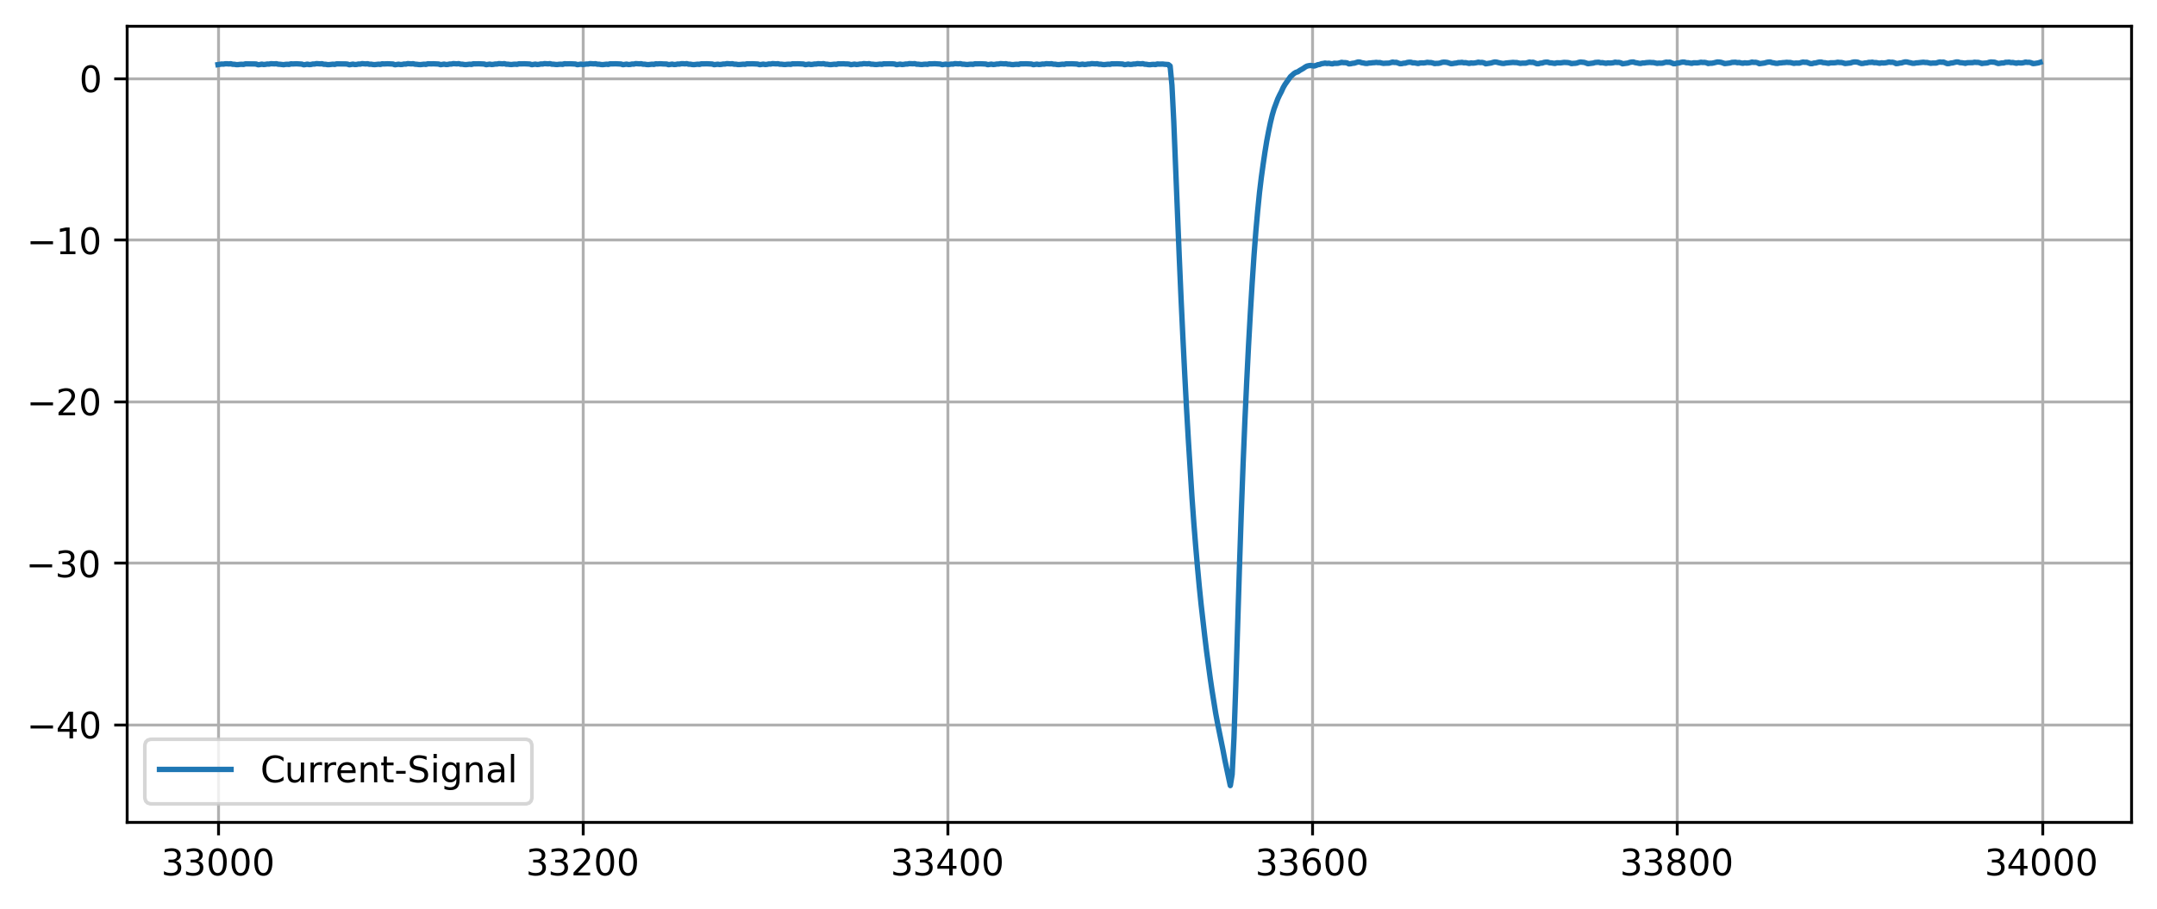
1. Introduction
2.
3.
4.
5.
Analysis of peak characteristics
Peak Detection in Time Series | N. Weidemann, N. Wijemanne
Notes:
Peaks can have different shapes and widths

Slide 8
1.
Introduction
2.
Experimental Setup
3.
Results
4.
5.
Evaluation
Conclusion
Peak Detection in Time Series | N. Weidemann, N. Wijemanne

Slide 9
1.
2. Experimental Setup
3.
4.
5.
Univariate (and linear) methods
Multivariate (and non-linear) methods
Threshold-Based
Moving-Average
Wavelet-Transform
DBSCAN
K-Means
Autoencoder
Isolation Forest
Broad variety of techniques from simple to complex and data-driven
Peak Detection in Time Series | N. Weidemann, N. Wijemanne
Notes:
Linear methods assume a linear relationship or operate via linear operations
Nonlinear methods model complex, nonlinear relationships
Univariate methods analyze one time series at a time
Multivariate methods can consider multiple dimensions/features simultaneously

Slide 10
1.
2. Experimental Setup
3.
4.
5.
General Overview of Pipeline
Model Tuning
Visualization
Data Processing
Model Building
Evaluation
Pseudo Labeling
Peak Detection in Time Series | N. Wijemanne

Slide 11
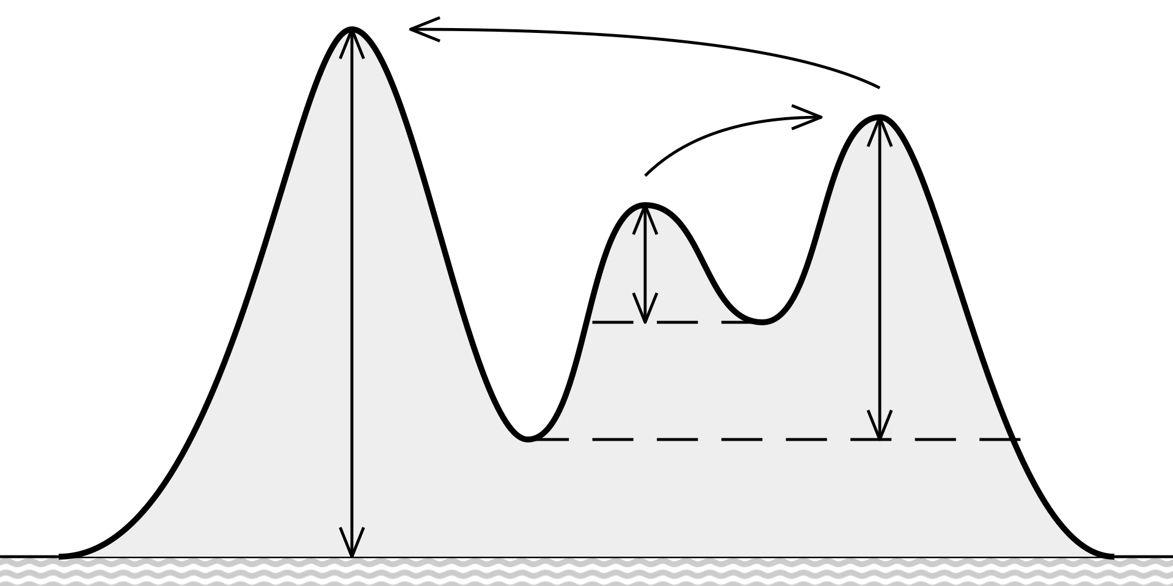
1.
2. Experimental Setup
3.
4.
5.
Threshold-Based Approach
A point is identified as a peak if:
It is a local maximum
Its value exceeds a threshold
Its prominence exceeds a threshold
Input-Feature-Variants
Torque with removed DC-offset
Absolute gradient of the command-speed
Peak Detection in Time Series | N. Weidemann
Notes:
Parameters: value-threshold, prominence-threshold
Prominence measures how much a peak stands out from surrounding valleys
A peak's prominence is the vertical distance between the peak and the lowest contour line that surrounds it and contains no higher peak
Higher prominence = more significant or isolated peak
Local maximum check: implicitly a window-size of 3

Slide 12
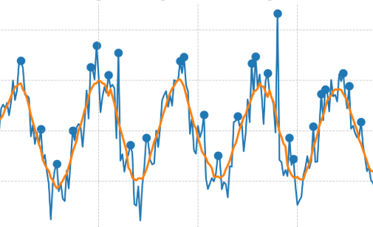
1.
2. Experimental Setup
3.
4.
5.
Moving-Average-Based Approach
Apply Moving-Average-Smoothing
Determine the difference to the original signal
Check for local maxima that exceed the threshold
Peak Detection in Time Series | N. Weidemann
Notes:
Parameters: window size, threshold for peak

Slide 13
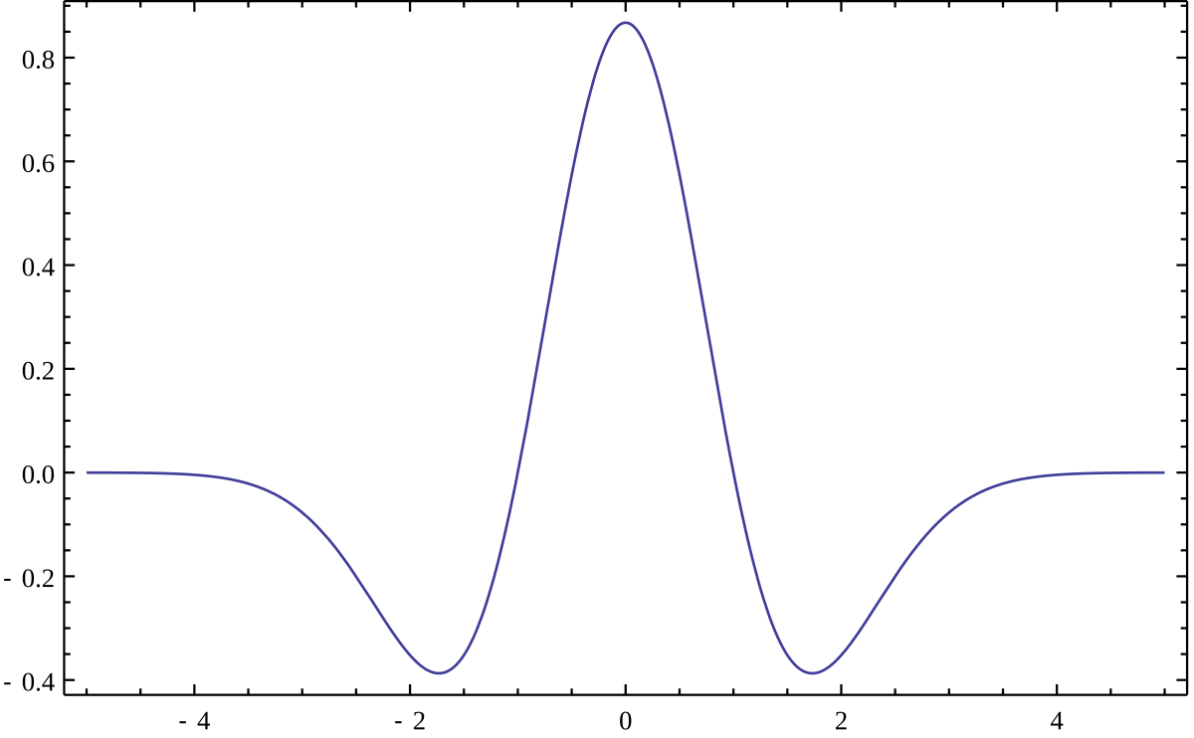
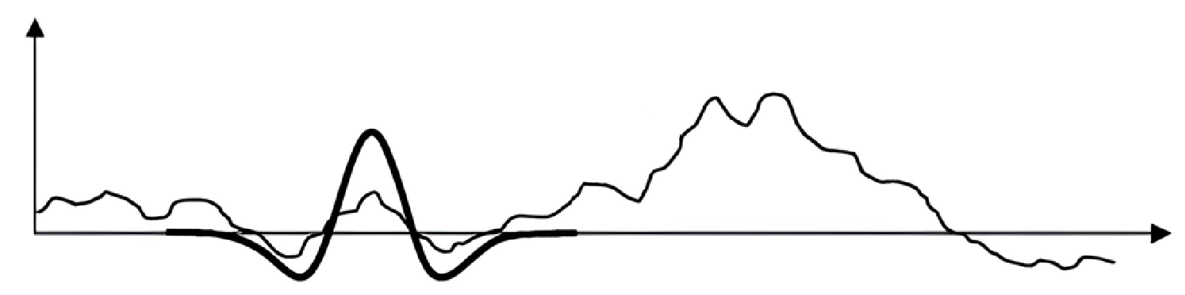
1.
2. Experimental Setup
3.
4.
5.
Wavelet-Transform
Using the Ricker wavelet as a basis function
Scale the wavelet and apply convolution on the target signal
High response indicates strong similarity
Peak Detection in Time Series | N. Weidemann
Notes:
Parameters: width/scale of the wavelet, (response-percentile)
Scipy considers every response in the lower 10th-percentile as noise
Convolution: shift -> normalize (local) -> dot-product
Matrix: coefficients across different scales (frequencies) and positions (time)
Peaks appear as strong, aligned coefficients across multiple scales
Scipy uses a signal-to-noise ratio logic implicitly to judge peak strength

Slide 14
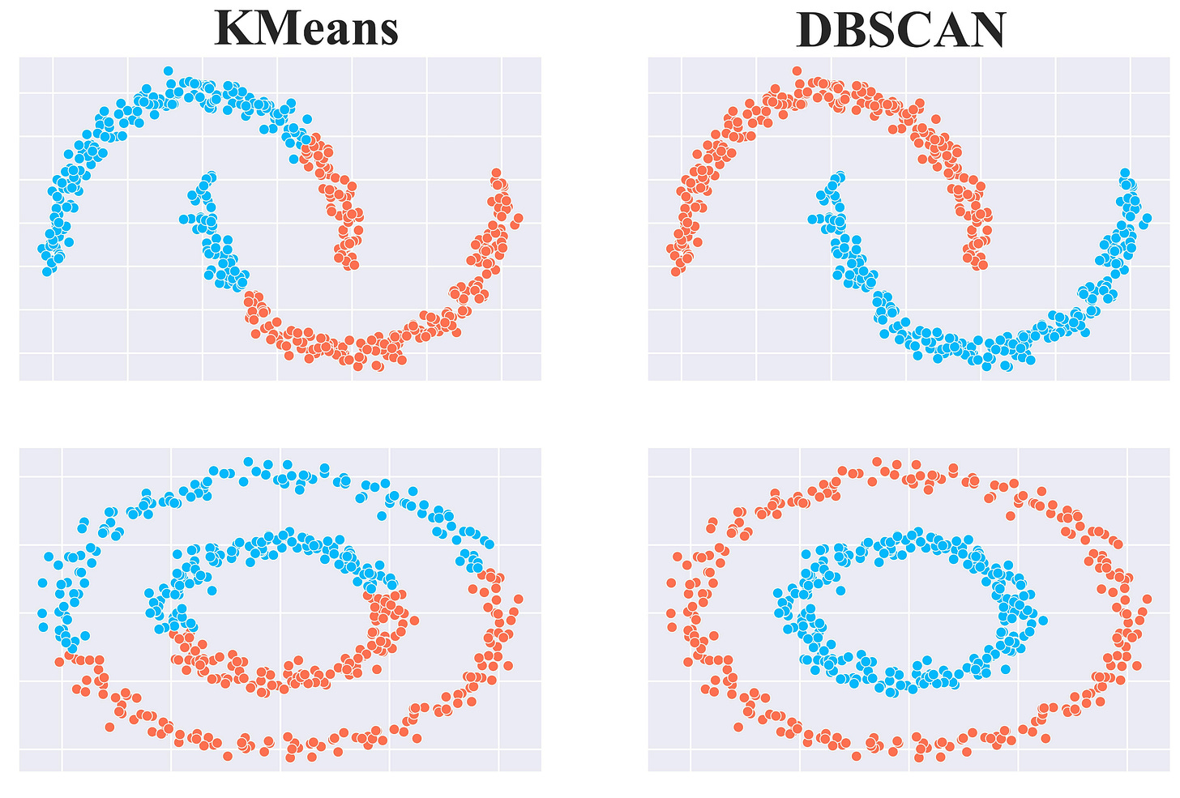
1.
2. Experimental Setup
3.
4.
5.
Clustering with K-Means
Training an autoencoder
Using Encoder to transform inputs into latent-space
Randomly initialize K centroids
Assign each point to the nearest centroid
Recompute the centroids by calculating the mean of all points assigned to it
Peak Detection in Time Series | N. Weidemann
Notes:
Parameters: number of clusters “k”
Autoencoder tries to reproduce the input
Repeat until changes in cluster assignments are minimal
Partitioning the data into k groups based on minimizing the distance between points and their assigned cluster centroids

Slide 15
1.
2. Experimental Setup
3.
4.
5.
Clustering with DBSCAN (Density-Based Spatial Clustering of Applications with Noise)
Training an autoencoder
Using Encoder to transform inputs into latent-space
Grouping together points that are closely packed
Marking those as outliers that lie alone in low-density regions
Peak Detection in Time Series | N. Weidemann
Notes:
Parameters: epsilon controls the radius of neighborhood (distance threshold)

Slide 16
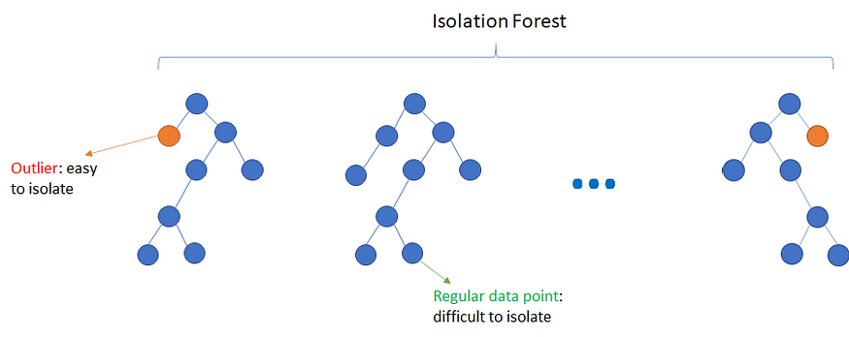
1.
2. Experimental Setup
3.
4.
5.
Isolation Forest
Robust for detecting outliers
Does not assume the distribution
However, not built for timeseries data
Create features (moving averages, lags, variances)
Train Isolation Forest
Score data points and identify peaks
Peak Detection in Time Series | N. Wijemanne
Notes:
Key parameter: contamination, number of trees
Uses Extremely Randomized Tree Regressors to separate anomalies from the rest of the data
Calculates an anomaly score for each data point and checks with a threshold. score depends on avg path length of an isolated point and average depth of all data points. closer to 1, strong anomaly
https://www.youtube.com/watch?v=kN--TRv1UDY

Slide 17
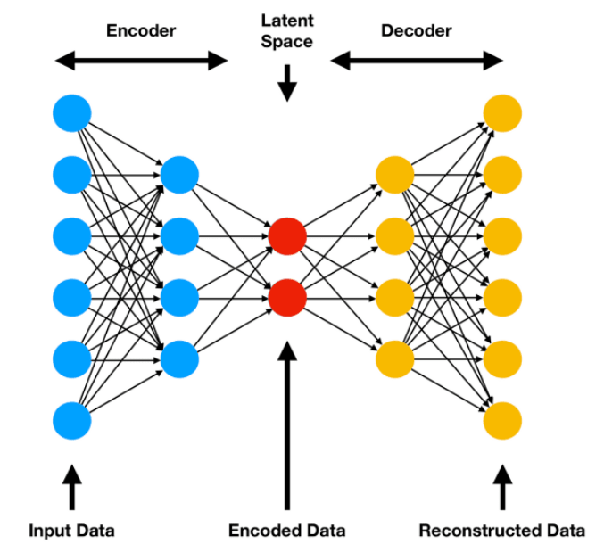
1.
2. Experimental Setup
3.
4.
5.
Encoder-Decoder Model
Detects anomalies for multivariate timeseries data by learning non-linear patterns
LSTMs – designed for sequences
High computational cost, requires a lot of hyperparameter tuning, and hard to interpret.
Train encoder–decoder model
Compute reconstruction error
Identify peaks based on threshold
Peak Detection in Time Series | N. Wijemanne
Notes:
An autoencoder is a neural network model that seeks to learn a compressed representation of an input, known as the latent space. And the decoder tries to recreate the features based on the compressed representation. The goal is to minimize the difference between the original and reconstructed data.
Long Short-Term Memory, or LSTM, network are specifically designed to support sequences of input data.
If the reconstructed output is different from the original input, it can show an anomaly or outlier which makes autoencoders useful for fraud detection and system monitoring.
LSTM training is slower than CNNs
Hyperparameters: Number of layers/units, Sequence length, Learning rate, Dropout Batch size
Other parameters: reconstruction error threshold → IQR/percentile etc.

Slide 18
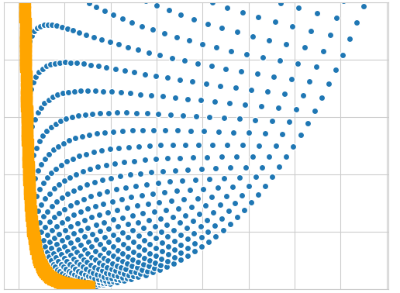
1.
2. Experimental Setup
3.
4.
5.
Determining the parameters
Since no ground truth is available, the quality of the parameters is estimated purely from statistical metrics:
Total number of peaks
Mean peak height
Mean peak prominence
Count of sequences without peaks
Using Pareto-Front-Analysis to select the best solution
Explain pareto front analysis -> visualization of example
Reason for use: majority of people use this in papers
Peak Detection in Time Series | N. Weidemann, N. Wijemanne
Notes:
Multi-Objective Optimization with Pareto-Front
Count of sequences without peaks -> indicating missed detections
Total number of peaks -> indicating sensitivity
Average peak height -> indicating proportion of true-positives
Average peak prominence -> indicating significance of the peaks

Slide 19
1.
Introduction
2.
Experimental Setup
3.
Results
4.
5.
Evaluation
Conclusion
Peak Detection in Time Series | N. Weidemann, N. Wijemanne

Slide 20
1.
2.
3. Results
4.
5.
Method | Features | Parameters |  | PC | MH | MP | SWP
Threshold-Based | Torque | Threshold = 5 | Min-Prominence = 1.1 | 2,977 | 5.03 | 0.89 | 0
Threshold-Based | Cmd.-Speed | Threshold = 0.7 | Min-Prominence = 1.1 | 660 | 6.74 | 0.13 | 0
Moving-Average | Not app. | Window = 1250 | Threshold = 2.0 | 56,111 | 1.89 | 0.13 | 1
Wavelet-Transform | Torque | Min-Width = 100 | Max-Width = 150 | 4,964 | 0.88 | 0.05 | 0
DBSCAN | Torque | Epsilon = 3.5 |  | 91,936 | 3.2 | 0.16 | 0
K-Means | Cmd.-Speed | K-Clusters = 2 |  | 365,670 | 1.2 | 0.09 | 0
Autoencoder | All inputs | Latent Dims = 8 | Contamination = 0.01 | 33,600 | 0.03 | 2.85 | 0
Isolation Forest | Torque | Estimators = 100 | Contamination = 0.01 | 73,476 | 4.37 | 0.08 | 0
PC: Peak-Count MH: Mean Height MP: Mean Prominence SWP: Sequences Without Peaks
Summarize parameters in one table
Peak Detection in Time Series | N. Weidemann, N. Wijemanne
Notes:
Optimal compromise between all metrics
Best tradeoff between amplitude and prominence with a more realistic peak count
It is common to manually checking each sample if it is challenging to generate ground truth data
Examples:
Robust multi-lane detection and tracking using adaptive threshold and lane classification
Robust lane detection and tracking with RANSAC and Kalman filter: „defining a ground truth for the data is extremely tedious; hence, it is commonly avoided. Consequently, detections were qualitative and based purely on visual inspection by single user”

Slide 21
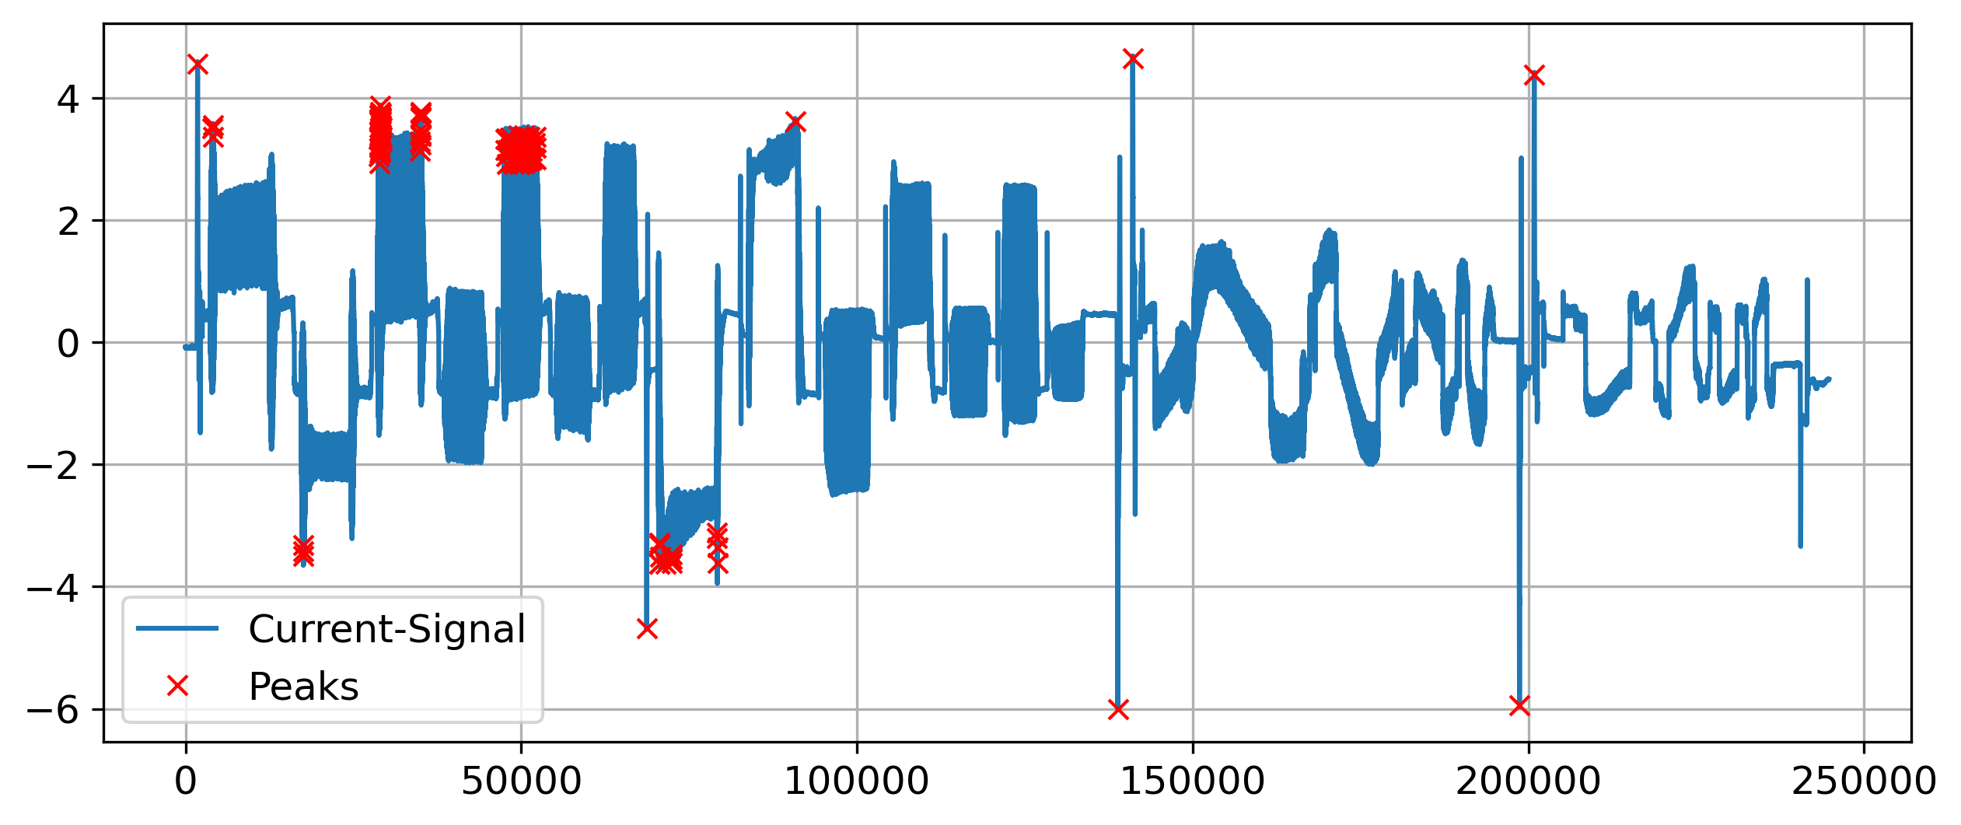
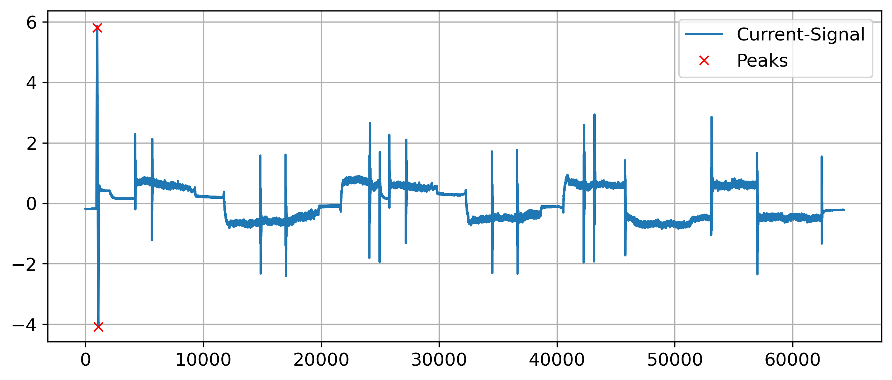
1.
2.
3. Results
4.
5.
Threshold-Based Detection (Torque)
Good precision on easy examples
Few true peaks were undetected
Peak Detection in Time Series | N. Weidemann, N. Wijemanne
Notes:
Good precision on easy examples with large outliers but fails on others with many false-positives -> bad generalization
Predicting one precise position and not an area
Can detect positive and negative peaks
Example-pictures: Seq2 ax1 Seq5 ax1

Slide 22


1.
2.
3. Results
4.
5.
Threshold-Based Detection (Cmd.-Speed)
Very high precision
Most of the true peaks were detected
Peak Detection in Time Series | N. Weidemann, N. Wijemanne
Notes:
No false-positives
Most of the true peaks were detected but not all (especially peaks with a smaller amplitude)
Predicting one precise position and not an area
Can detect positive and negative peaks
Example-pictures: Seq2 ax1 Seq5 ax1

Slide 23
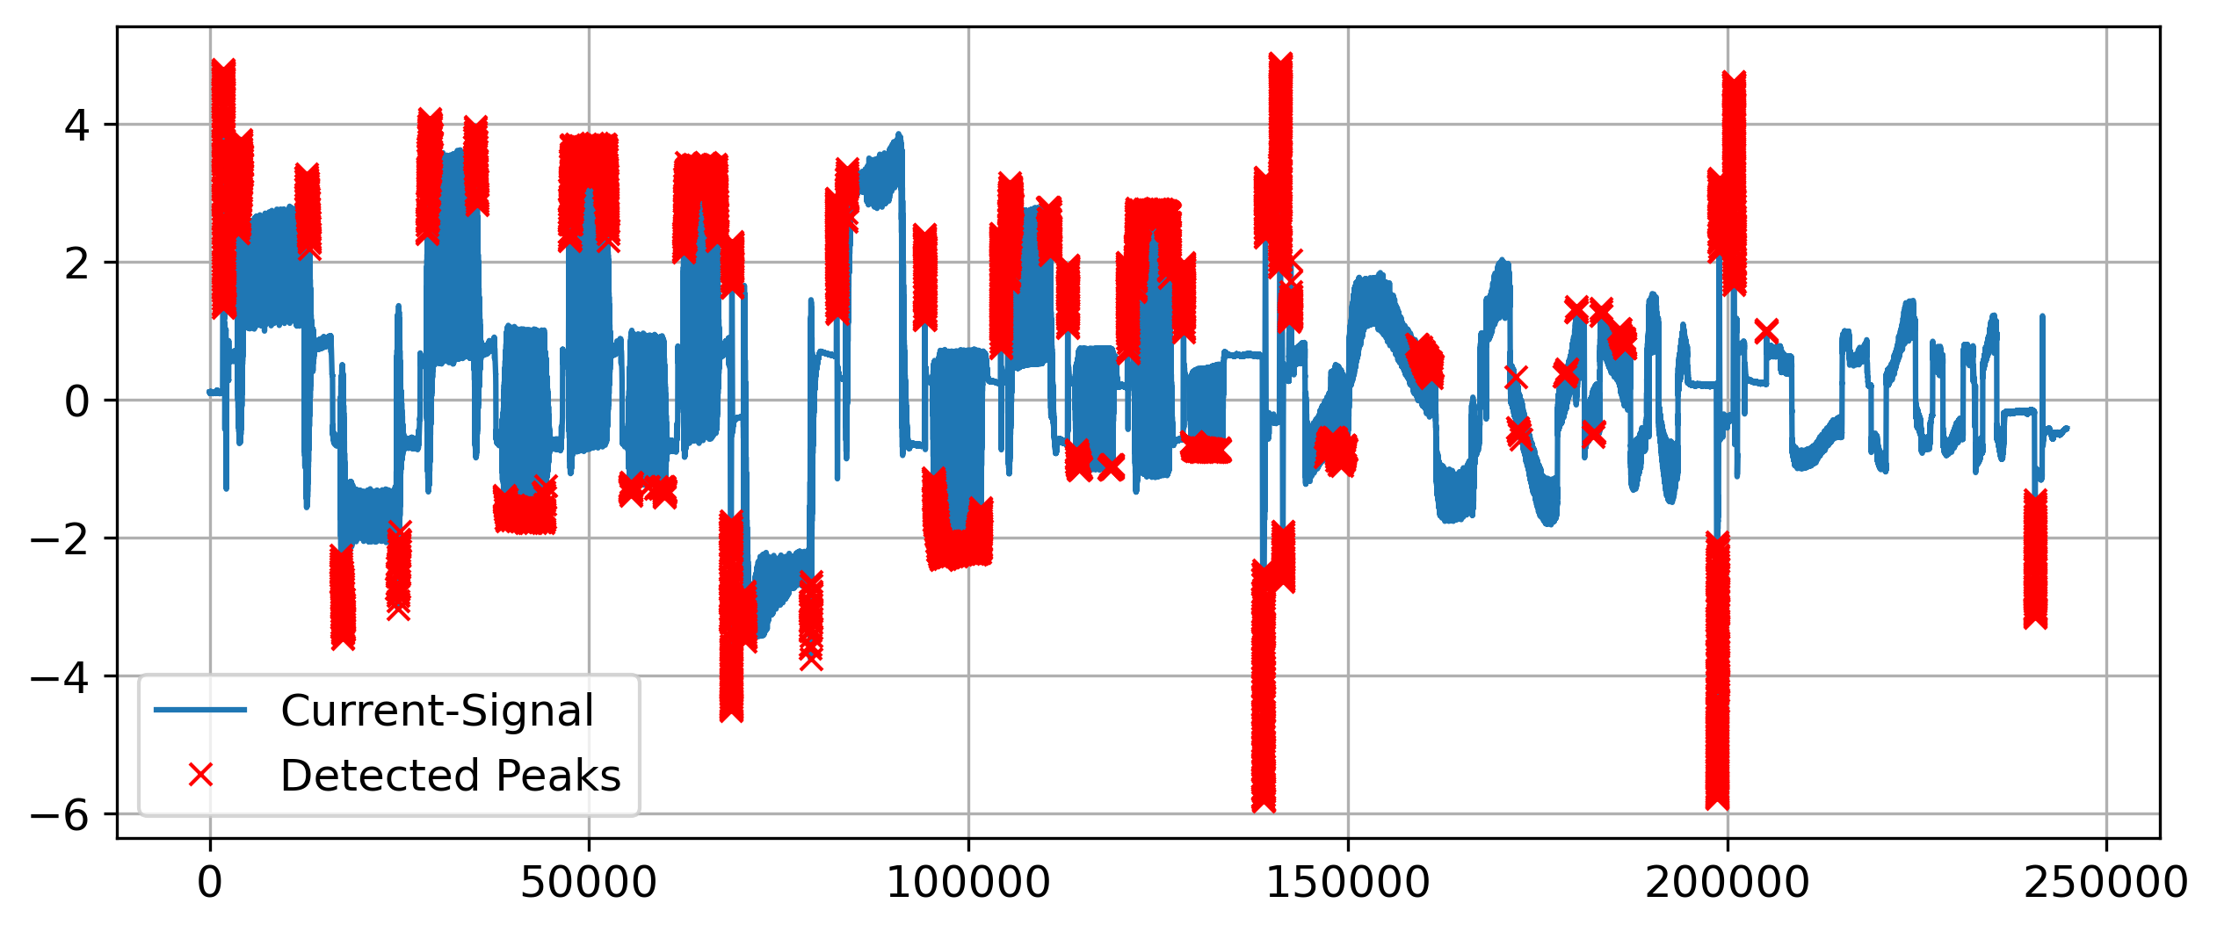
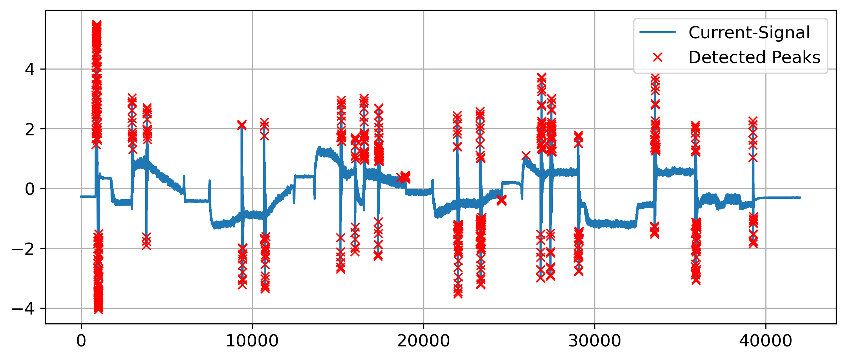
1.
2.
3. Results
4.
5.
Moving Average-Based Detection
Identifies a majority of the peaks.
Was only unable to properly detect a specific pattern – brings down average of metrics
Peak Detection in Time Series | N. Weidemann, N. Wijemanne
Notes:
bad generalization, if threshold can be specified for each machine type, would work better.
Can detect positive and negative peaks
Example-pictures: Seq2 ax1 Seq5 ax1

Slide 24
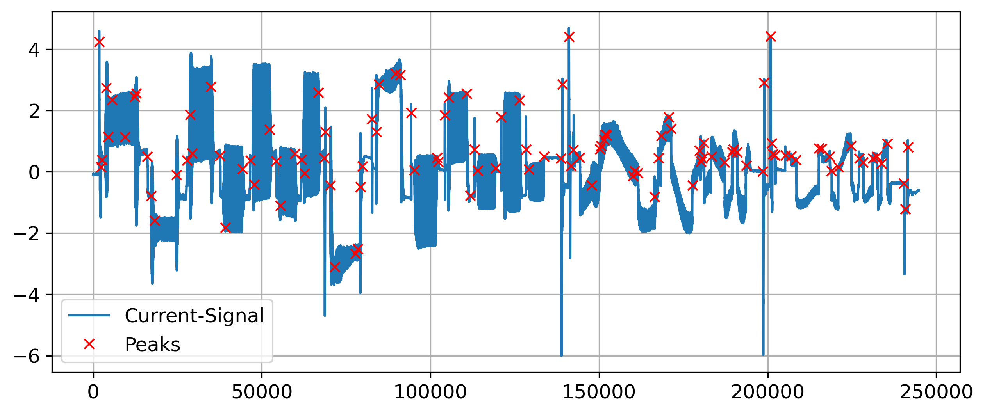
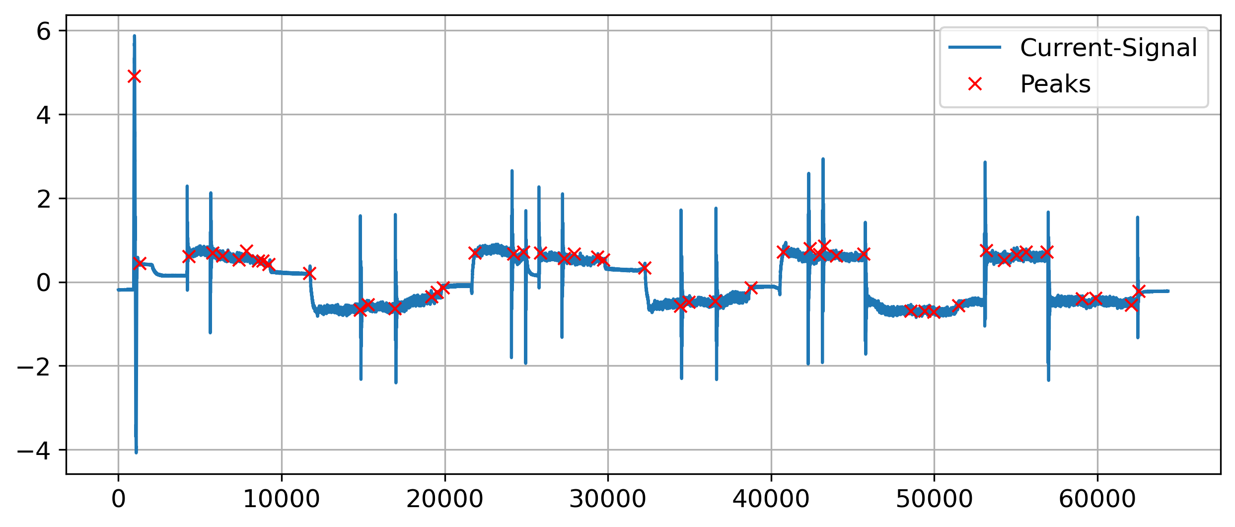
1.
2.
3. Results
4.
5.
Wavelet Transform
Very bad precision
Most of the true peaks were detected but not all
Possible reasons of failure:
Peaks have different shapes and widths
Shape is indistinguishable from noise
Peak Detection in Time Series | N. Weidemann, N. Wijemanne
Notes:
Many false-positives
Predicting one precise position and not an area
Can detect only positive peaks (with one single wavelet)
Example-pictures: Seq2 ax1 Seq5 ax1

Slide 25
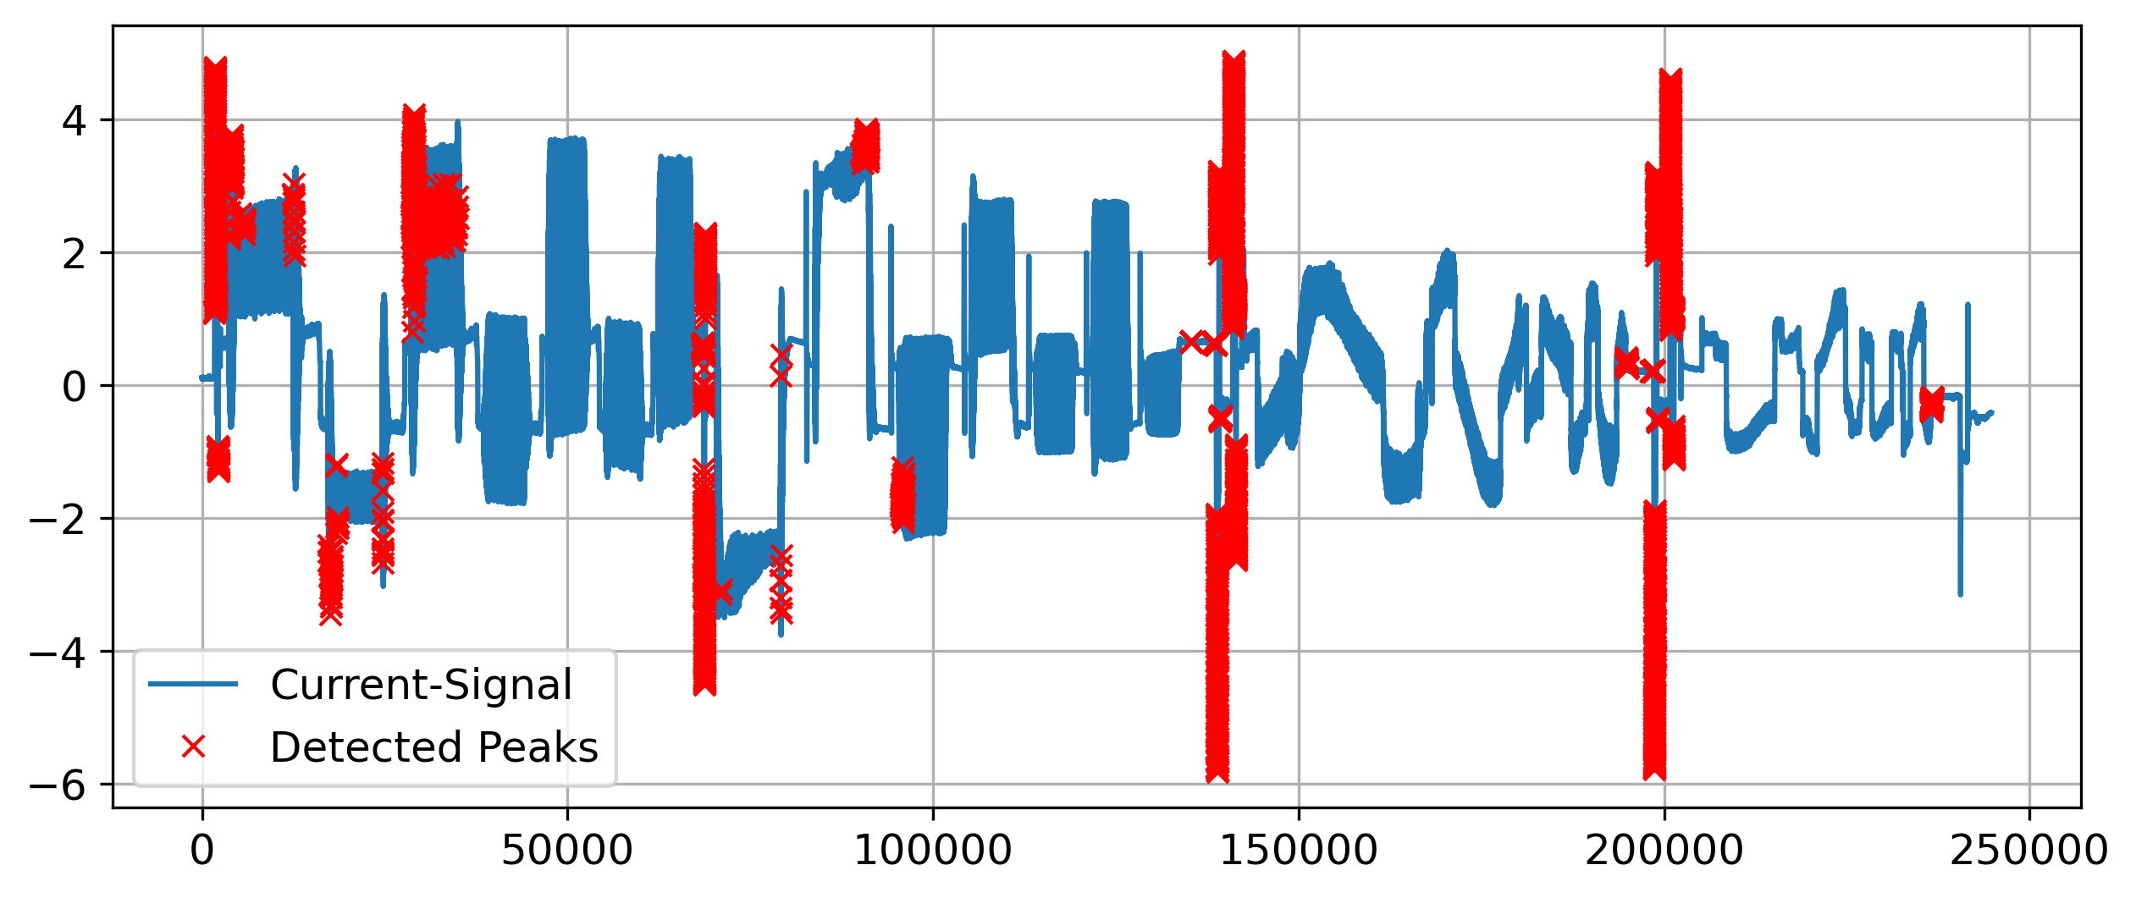
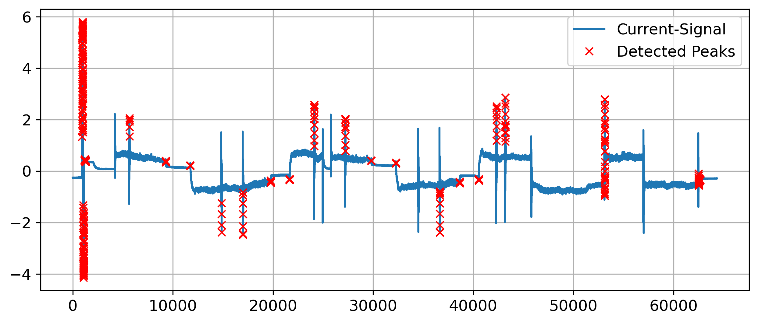
1.
2.
3. Results
4.
5.
Isolation Tree
Not many false-positives issued on the sequences
Many peaks were not detected
Characteristic of marking the whole peak area instead of just one precise position
Can detect positive and negative peaks
Peak Detection in Time Series | N. Weidemann, N. Wijemanne

Slide 26
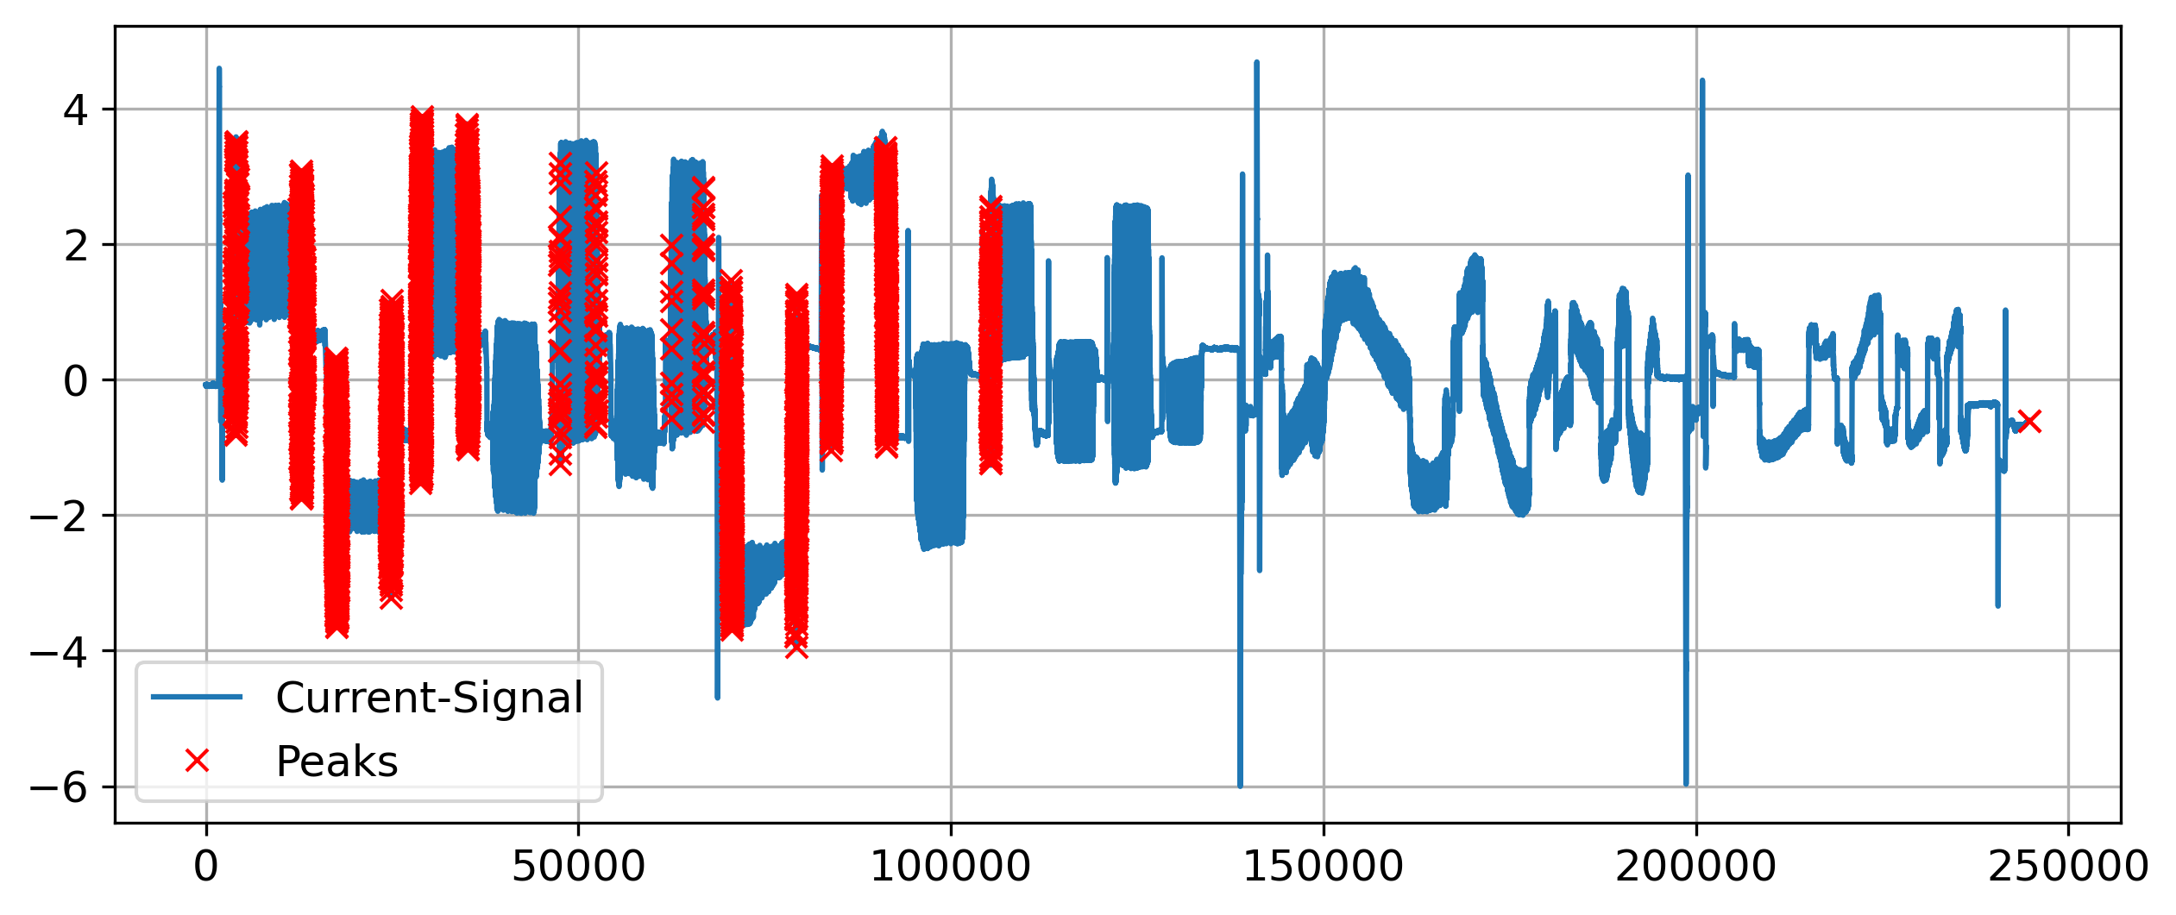
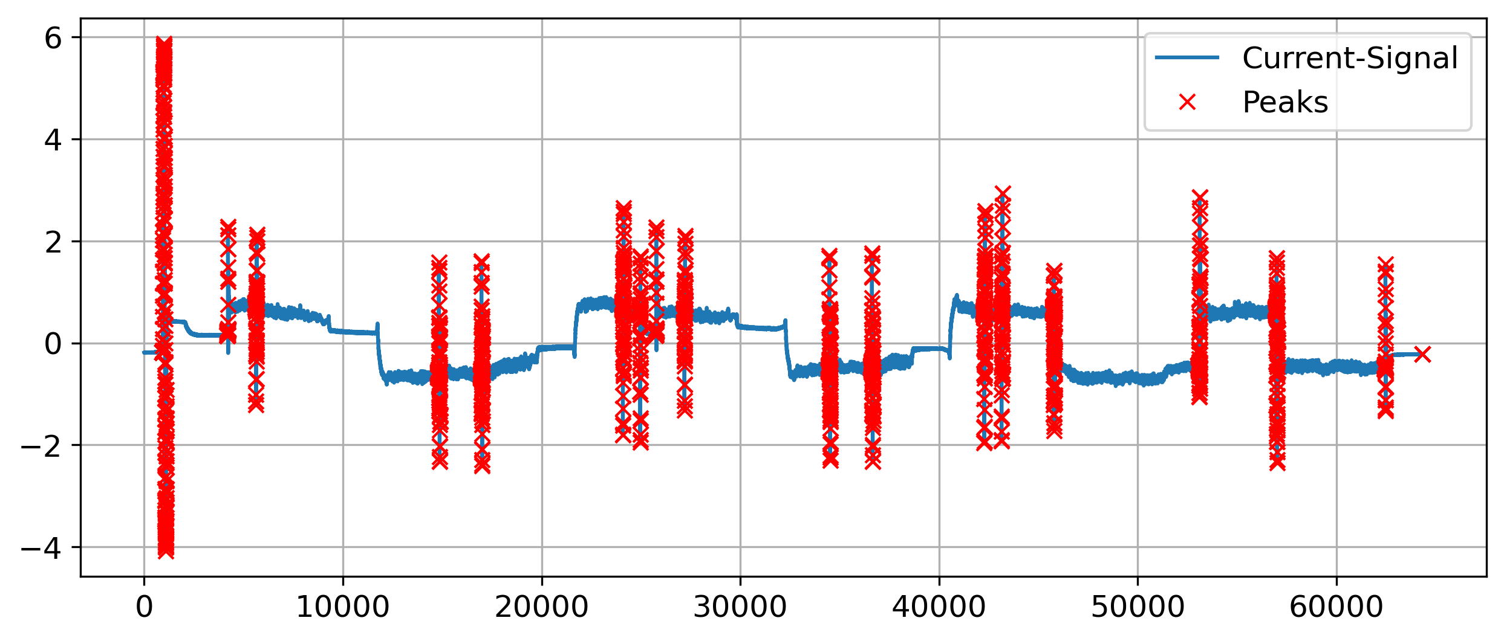
1.
2.
3. Results
4.
5.
Clustering with DBSCAN
High precision
Some peaks were not detected
Recognizable tendency of detecting peaks
Peak Detection in Time Series | N. Weidemann, N. Wijemanne
Notes:
Almost no false-positives
Marking the whole peak area instead of just one precise position
Can detect positive and negative peaks
Example-pictures: Seq2 ax1 Seq5 ax1

Slide 27
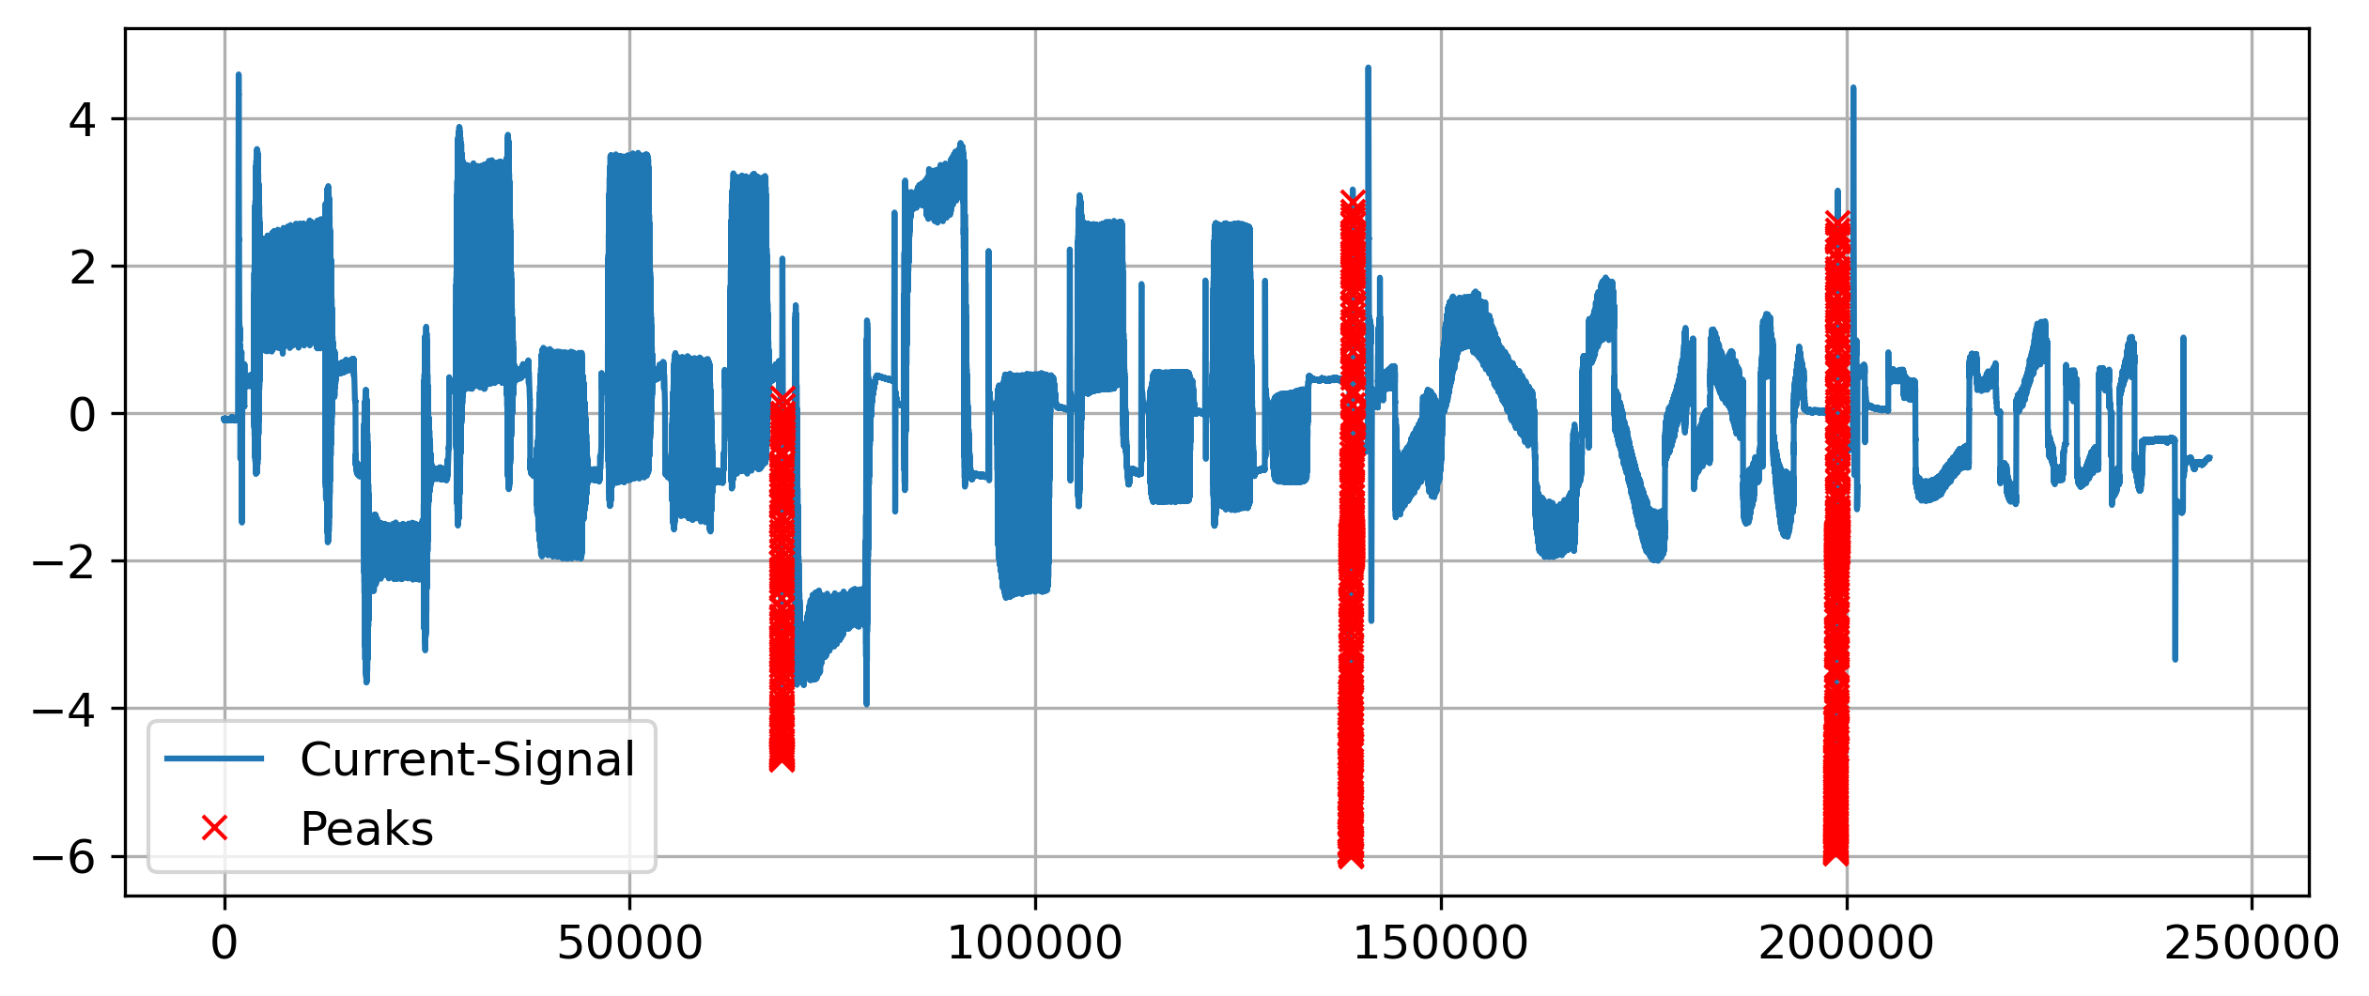
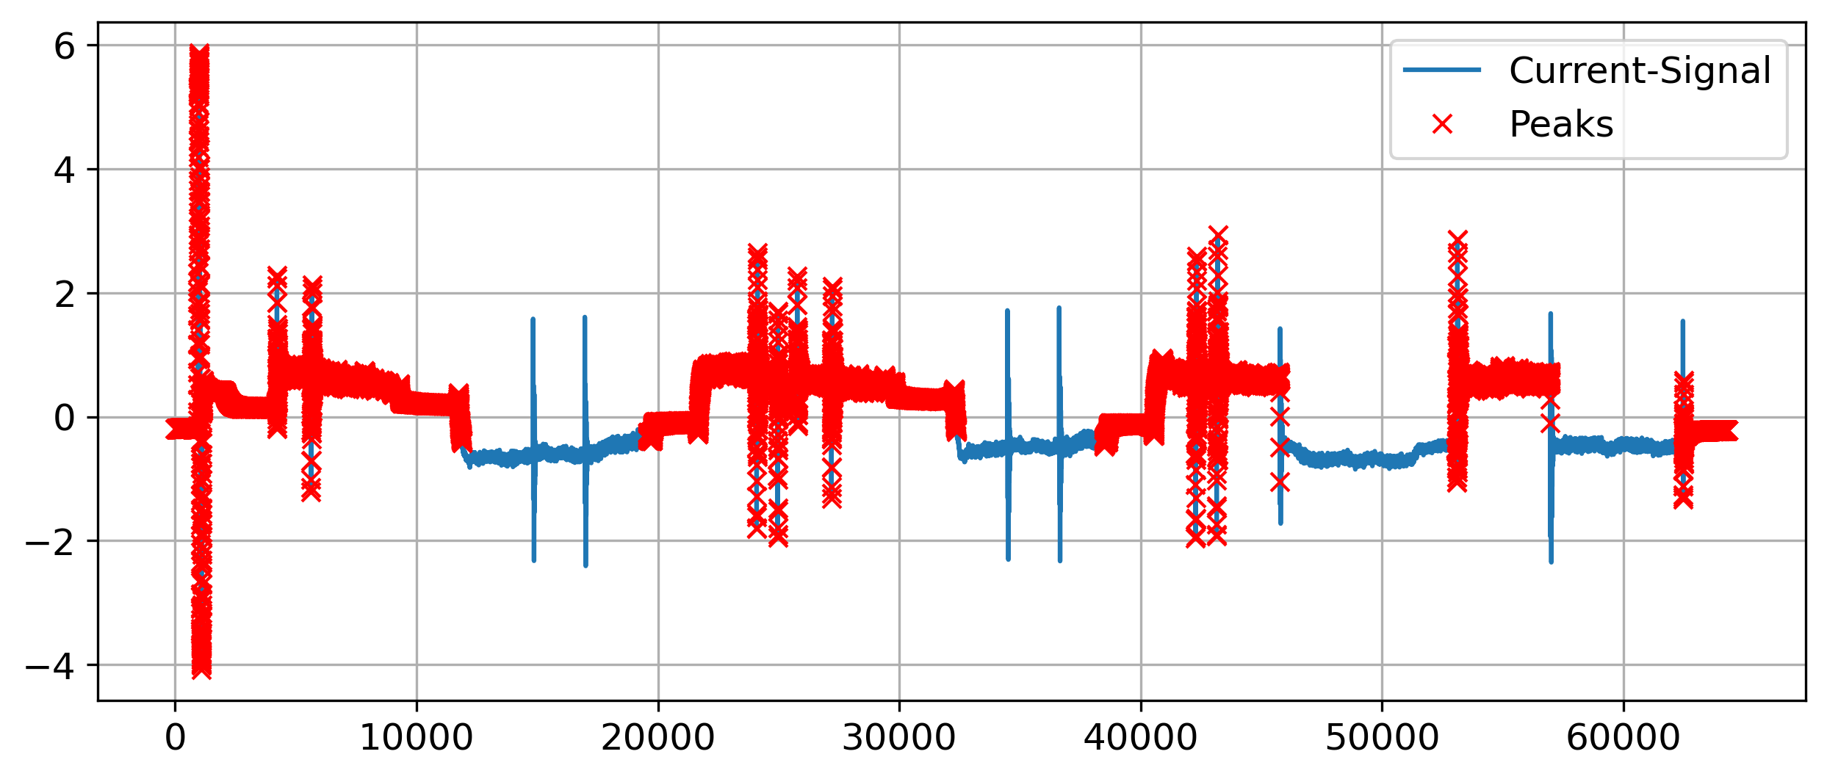
1.
2.
3. Results
4.
5.
Clustering with K-Means
False-positives issues on some sequences
Many peaks were undetected
Unreliable predictions
Peak Detection in Time Series | N. Weidemann, N. Wijemanne
Notes:
Can detect positive and negative peaks
Marking the whole peak area instead of just one precise position
Example-pictures: Seq2 ax1 Seq5 ax1

Slide 28
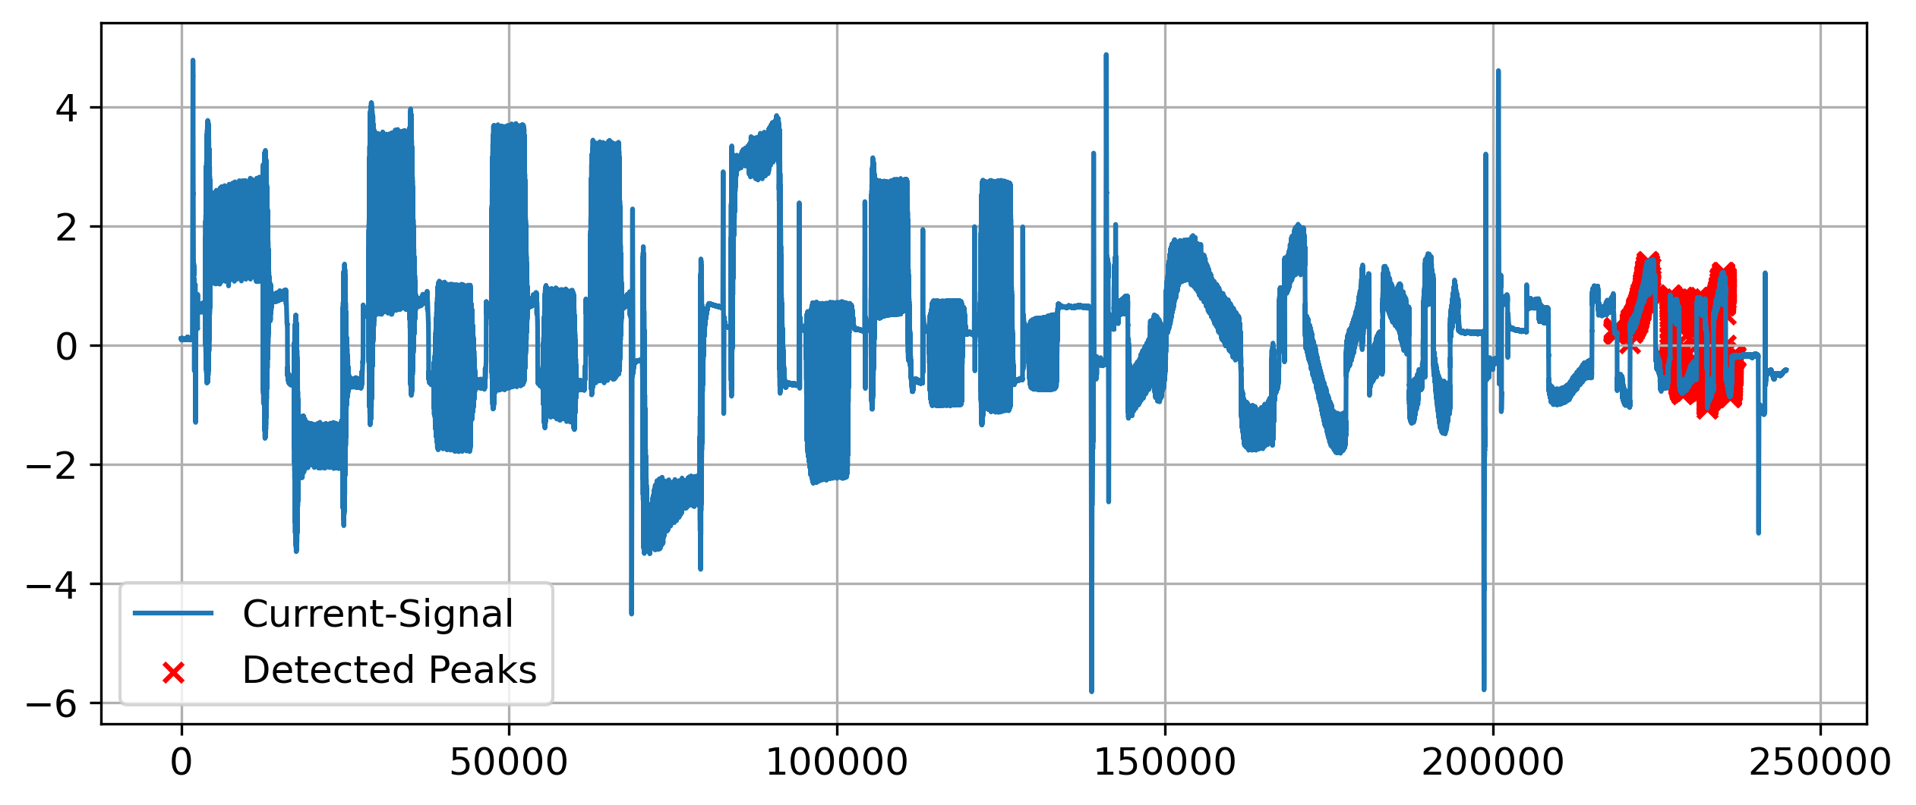
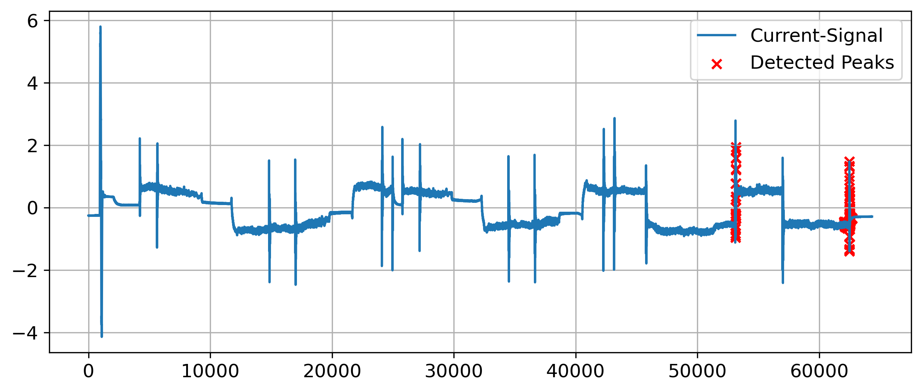
1.
2.
3. Results
4.
5.
Autoencoder
Not many false-positives issued on the sequences
Many peaks were not detected
Can detect positive and negative peaks
Detects smaller deviations but sometimes unable to identify larger deviations → not good
Peak Detection in Time Series | N. Weidemann, N. Wijemanne

Slide 29
1.
Introduction
2.
Experimental Setup
3.
Results
4.
5.
Evaluation
Conclusion
Peak Detection in Time Series | N. Weidemann, N. Wijemanne

Slide 30
1.
2.
3.
4. Evaluation
5.
Key Criteria
Precision and Recall
Computational costs / speed / complexity
Applicability
Robustness and Generalization
Draft
Peak Detection in Time Series | N. Weidemann, N. Wijemanne

Slide 31
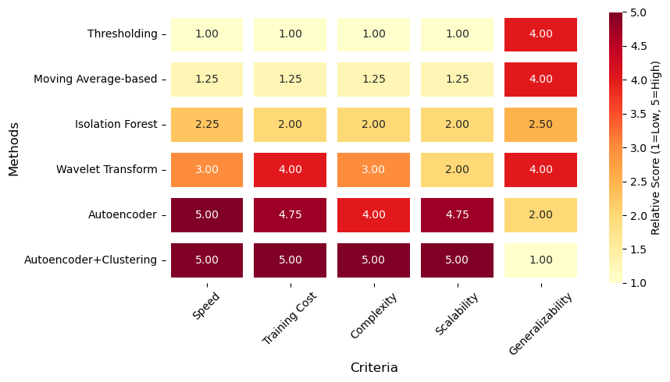
1.
2.
3.
4. Evaluation
5.
Computational Cost and Complexity of Peak Detection Methods
Peak Detection in Time Series | N. Weidemann, N. Wijemanne

Slide 32
1.
2.
3.
4. Evaluation
5.
Comparison with pseudo labels
Draft
Peak Detection in Time Series | N. Weidemann, N. Wijemanne
Notes:
Metrics just show how similar the prediction is to the percentile-approach
Low recall for all methods that predict precise positions and not an area
Threshold-Based Torque has high precision because it uses the “same” feature as the percentile-approach

Slide 33
1.
2.
3.
4. Evaluation
5.
Best practice: Threshold-Based Detection
Best results based of visual inspections
Fast computation with low resource allocation
Few parameters to optimize
High precision
Draft
Peak Detection in Time Series | N. Weidemann, N. Wijemanne
Notes:
Feature-processing forces the user to analyze and understand the data, which can already give some insights into the reason for the anomalies
Drawback: struggles to generalize on unprocessed data with different signal-types

Slide 34
1.
Introduction
2.
Experimental Setup
3.
Results
4.
5.
Evaluation
Conclusion
Peak Detection in Time Series | N. Weidemann, N. Wijemanne

Slide 35
1.
2.
3.
4.
5. Conclusion
Recommended workflow
1. Start with a simple method
2. Select and develop suitable input features
3. Optimize the parameters
4. Try a more complex approach
Failure
Success
Done
Draft
Peak Detection in Time Series | N. Weidemann, N. Wijemanne

Slide 36
1.
2.
3.
4.
5. Conclusion
Findings
Anomalies are likely caused by sudden changes in the commanded speed
Sharp edges seem to cause the peaks in the current
There seems to be an issue within the planning unit
Peak Detection in Time Series | N. Weidemann, N. Wijemanne
Notes:
commanded speed: speed setpoint from the trajectory planner to the motor controller
Spindle signal looks like a discrete signal with hard edges (instead of smooth, continuous transitions

Slide 37
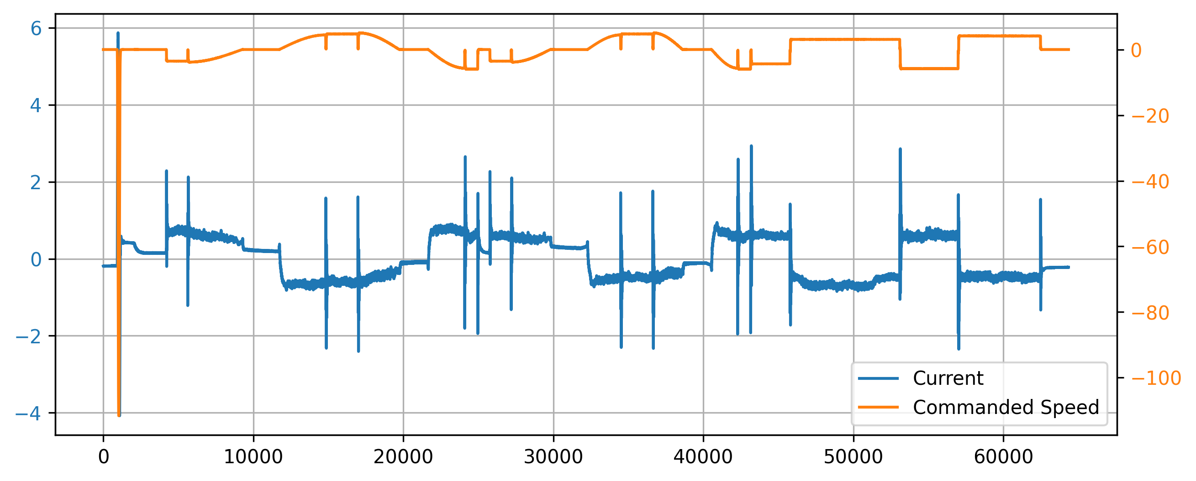
1.
2.
3.
4.
5. Conclusion
3 different types of anomalies
Large outlier
Signal flickers to zero
Jumping between quantized levels
1.
2.
3.
Peak Detection in Time Series | N. Weidemann, N. Wijemanne

Slide 38
1.
2.
3.
4.
5. Conclusion
Ideas for improvement
Consider the width of each peak and its proximity to neighboring peaks
Rescale the signals by a material-specific factor
Cluster formation: peaks that are close to each other are combined
Peak Detection in Time Series | N. Weidemann, N. Wijemanne
Notes:
Rescale the signals by a material-specific factor to align dynamics in the current caused by normal workload within the same zone to improve generalization
Cluster formation (Coalescence): peaks that are close to each other (within a window distance k) are combined so that only the highest peak remains
(Apply smoothing to the signal to filter noise and remove unsignificant peaks)

Slide 39
Peak Detection in Time Series
Presentation of Final Results
Thank You For Your Attention!
Nestor Weidemann
Mail: nestor.weidemann@st.ovgu.de
Nathira Wijemanne
Mail: nathira.wijemanne@st.ovgu.de

Slide 40
References for Graphics
[1] https://www.hubs.com/de/wissensbasis/3d-druck-vs-cnc-bearbeitung/
[1] https://www.fptindustrie.com/deu/
[2] https://www.mdpi.com/1996-1073/17/15/3659
[3] https://en.wikipedia.org/wiki/Ricker_wavelet
[4] https://link.springer.com/article/10.1007/s10950-019-09845-y https://www.researchgate.net/figure/Convolution-of-a-signal-with-a-wavelet-function-Part-of-this-figure-is-taken-from-1_fig1_51918746
[5] https://en.wikipedia.org/wiki/Topographic_prominence
[6] https://blog.dailydoseofds.com/p/the-limitations-of-dbscan-clustering
[7]
Peak Detection in Time Series | N. Weidemann, N. Wijemanne
Notes:
Clustering method -> Hyper parameter tuning
Autoencoder ->
Pseudo labels for evaluation for each approach
Considering efficiency and computational cost when evaluating

Slide 41
References for Graphics
[8] https://waterprogramming.wordpress.com/tag/pareto-dominance/
[9]
Peak Detection in Time Series | N. Weidemann, N. Wijemanne
Notes:
Clustering method -> Hyper parameter tuning
Autoencoder ->
Pseudo labels for evaluation for each approach
Considering efficiency and computational cost when evaluating

Slide 42
Backup
Peak Detection in Time Series | N. Weidemann, N. Wijemanne

Slide 43

F1-Score
Combines precision and recall into one metric
$F1 Score=2∗\frac{Precision∗Recall}{Precision+Recall}$
$Precision=\frac{TP}{TP+FP}$
$Recall=\frac{TP}{TP+FN}$
Peak Detection in Time Series | N. Weidemann, N. Wijemanne

Slide 44
Dataset
Number of Rows: ~1.6 Million
Time Series data across:
2 Machine Types (CMX1, DMC2)
2 Materials (AL, S)
2 Components (CP1, CP2)
-> 8 different measurements
Variables measured across 4 axes: X (1), Y (2), Z (3) and Spindle (6)
Target Variable: Current
Possible Input Variables: Load, Motor shaft positions (actual & desired), Control deviation, Torque, Feedforward velocity, Feedforward torque, Commanded Speed, and etc.
Peak Detection in Time Series | N. Weidemann, N. Wijemanne

Slide 45
Dataset
Relationships:
For all axes: Current ∝ Torque
For all Z: Current ∝ Load (>0.9 correlation)
Machine CMX1, Spindle: Current ∝ Load (>0.9 correlation)
Machine DMC2, Y & Z: Current ∝ Encoder Positions (>0.9 correlation)
Component 2, Y: Current ∝ Load (>0.9 correlation)
Component 1, Spindle: Current ∝ Load (~0.7 correlation)
Peak Detection in Time Series | N. Weidemann, N. Wijemanne

Slide 46
Intermediate Results
Sensitivity analysis was done for each technique to identify model that is best suited
Pseudo labels were used for metric calculation and evaluation
Metrics used:
F1 Score (using Pseudo labels)
Count of sequences with no peaks
Total number of peaks
Average peak height
Average peak prominence
Peak Detection in Time Series | N. Weidemann, N. Wijemanne
Notes:
· The prominence of a peak measures how much the peak stands out due to its intrinsic height and its location relative to other peaks. It's not just how high the peak is, but how independent it is from nearby peaks.

Slide 47

Explanation of the approaches
Isolation Forest
Uses Extremely Randomized Tree Regressors to separate anomalies from the rest of the data
Peak Detection in Time Series | N. Weidemann, N. Wijemanne
Notes:
Calculates an anomaly score for each data point and checks with a threshold. score is depends on avg path length of an isolated point and average depth of all data points. closer to 1, strong anomaly https://www.youtube.com/watch?v=kN--TRv1UDY

Slide 48
Results – Isolation Tree
Selected parameters
Features: Torque, Moving Average of Torque as input
Parameters:
Contamination: 0.01
Number of estimators: 100
Higher median F1 score (against pseudo labels ) and more realistic peak count
However, better results for certain sequences → Not very generalizable
Peak Detection in Time Series | N. Weidemann, N. Wijemanne

Slide 49
Explanation of the approaches
Autoencoder Model
Peak Detection in Time Series | N. Weidemann, N. Wijemanne
Notes:
Encoder: The encoder takes the input data (e.g., an image, a sound clip, or a text document) and compresses it into a lower-dimensional representation, known as the latent space or encoded representation.
Decoder: The decoder takes the compressed representation and tries to reconstruct the original input. The goal is to minimize the difference between the original and reconstructed data.
If the reconstructed output is different from the original input, it can show an anomaly or outlier which makes autoencoders useful for fraud detection and system monitoring.
https://towardsdatascience.com/auto-encoder-what-is-it-and-what-is-it-used-for-part-1-3e5c6f017726/

Slide 50
Results – Autoencoder
Selected parameters
Features: Torque as input
Parameters:
Contamination: 0.01
Latent dims: 8
Epochs: 50
Batch size: 64
Peaks were not detected at all in some sequences
However, good results for certain sequences → Not very generalizable
Peak Detection in Time Series | N. Weidemann, N. Wijemanne

Slide 51
1.
2.
3. Results
4.
5.
Method | Features | Parameters |  | Precision | Recall | PC | MH | MP | PS
Threshold-Based | Torque | Threshold = 5 | Min-Prominence = 1.1 | 0.903 | 0.013 | 2977 | 5.03 | 0.89 | 0
Threshold-Based | Cmd.-Speed | Threshold = 0.7 | Min-Prominence = 1.1 | 0.717 | 0.007 | 660 | 6.74 | 0.13 | 0
Moving Average | Not app. | Window = 1250 | Threshold = 2.0 |  |  | 56111 |  |  | 1
Wavelet-Transform | Torque | Min-Width = 100 | Max-Width = 150 | 0.044 | 0.002 | 4964 | 0.88 | 0.05 | 0
DBSCAN | Torque | Epsilon = 3.5 |  | 0.489 | 0.478 | 91936 | 3.2 | 0.16 | 0
K-Means | Cmd.-Speed | K-Clusters = 2 |  | 0.469 | 0.272 | 365670 | 1.2 | 0.09 | 0
Autoencoder | All inputs | Latent Dims = 8 | Contamination = 0.01
Isolation Forest | Torque | Estimators = 100 | Contamination = 0.01 |  |  | 73476 |  |  | 0
PC: Peak-Count MH: Mean Height MP: Mean Prominence PS: Peakless Sequences
Summarize parameters in one table
Peak Detection in Time Series | N. Weidemann, N. Wijemanne
Notes:
Optimal compromise between all metrics
Best tradeoff between amplitude and prominence with a more realistic peak count

